Slide 1

Understanding excimer formation by anthracene dimer inside octa-acid with TDDFT and QM/MM
Shubhojit Banerjee
180206
Department of Chemistry
Supervisor: Dr. Varadharajan Srinivasan
Tuesday, April 20, 2021

Slide 2
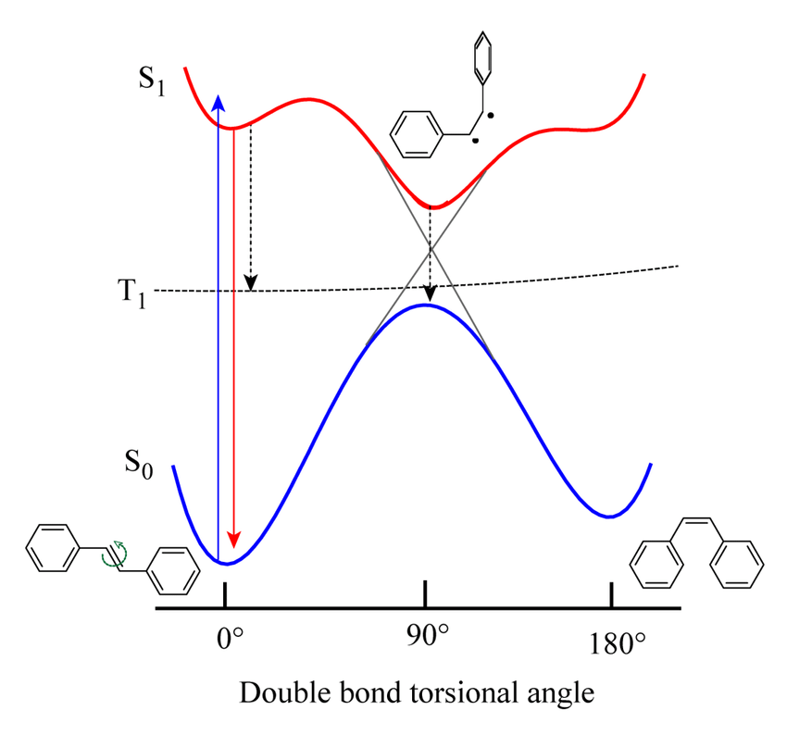
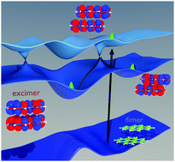
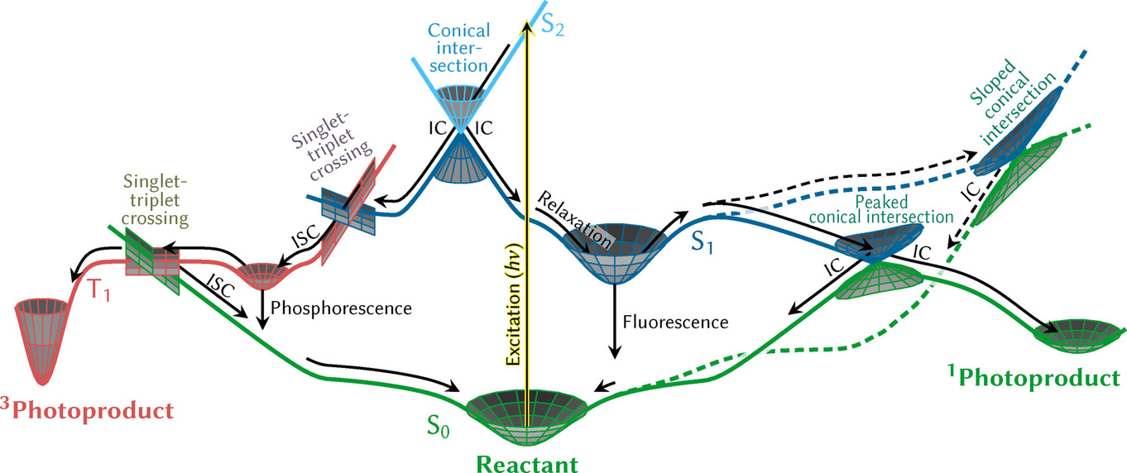
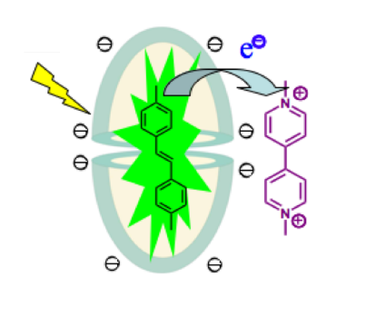
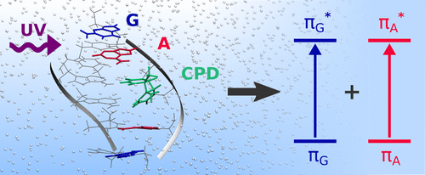
Photochemistry – an overview
5. Photoisomerization
2. Excimer formation
1. Schematic of photochemical process
1. S. Mai, L. González, Angew. Chem. Int. Ed. 2020, 59, 16832.
2. Phys. Chem. Chem. Phys., 2017,19, 25002-25015
3. J. Phys. Chem. A 2020, 124, 44, 9133–9140)
4. J. Phys. Chem. B 2018, 122, 1, 328–337
5. Tuhin Khan, DOI: 10.13140/RG.2.2.29866.11201
3. Photoinduced electron
Transfer
4. DNA repair

Slide 3
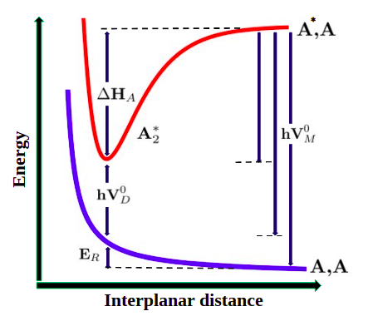
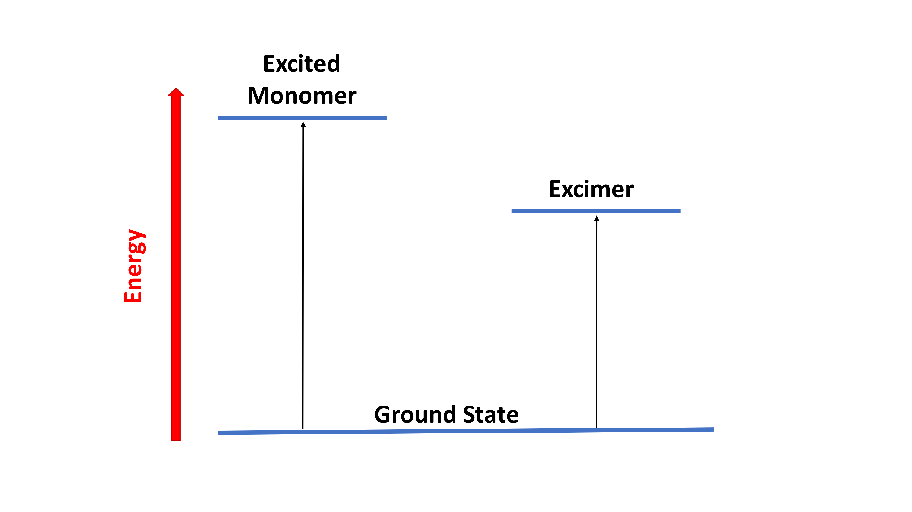
Excimer
An excimer is a dimeric species bound in the excited state but undergoes dissociation in the ground state.
Some characteristic excimer properties are that it shows structureless, broad, and red-shifted maxima in the emission spectrum when compared with its monomer.
Excimer is a mixture of charge transfer as well as local excited state.
Diagrammatic representation of Energy levels of monomer vs. excimer

Slide 4
Motivation
Inside solvents, anthracene undergoes photodimerization upon excitation, does not form excimer.
Excimer emission from anthracene could be recorded at 77 K in an organic glass. But upon warming the matrix the excimer emission disappears ⁽¹⁾.
In solution, excimer emission is achieved by covalently linking the two anthracene molecules. But, one should note that upon functionalization, we are no longer dealing with the parent system.
An effective way is supramolecular encapsulation where two molecules are brought closer through weak non-covalent interactions ⁽²⁾ .
Exploring the insight of excimer formation is very important.
hν
2
1. Chandross, E. A. Photolytic Dissociation of Dianthracene. J. Chem. Phys. 1965, 43, 4175−4176.​
2. J. Am. Chem. Soc. 2021, 143, 4, 2025–2036

Slide 5
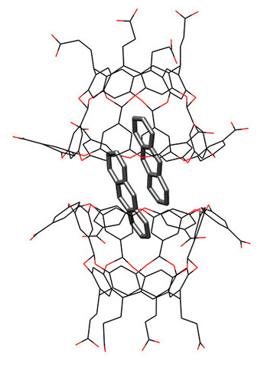
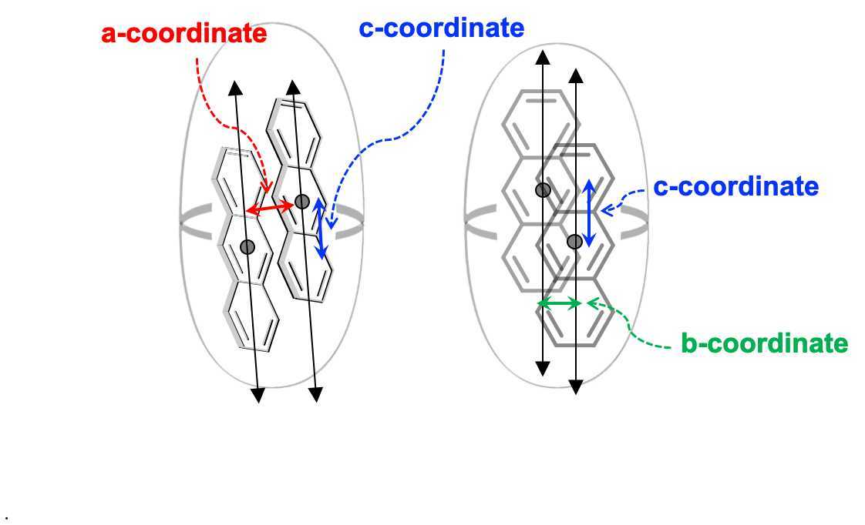
Structure of An₂@OA₂ complex
a) b)
Structure of the AN₂@OA₂ complex.
Schematic representation of a, b, c axis .

Slide 6
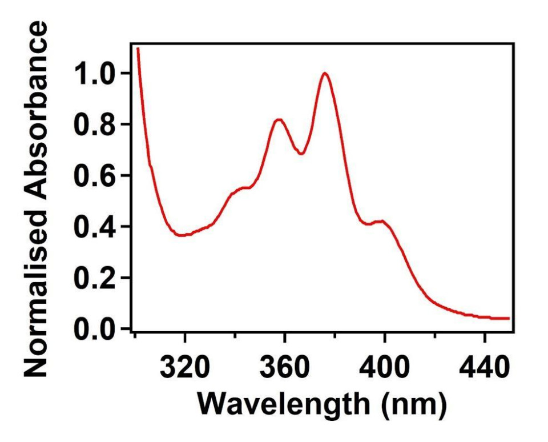
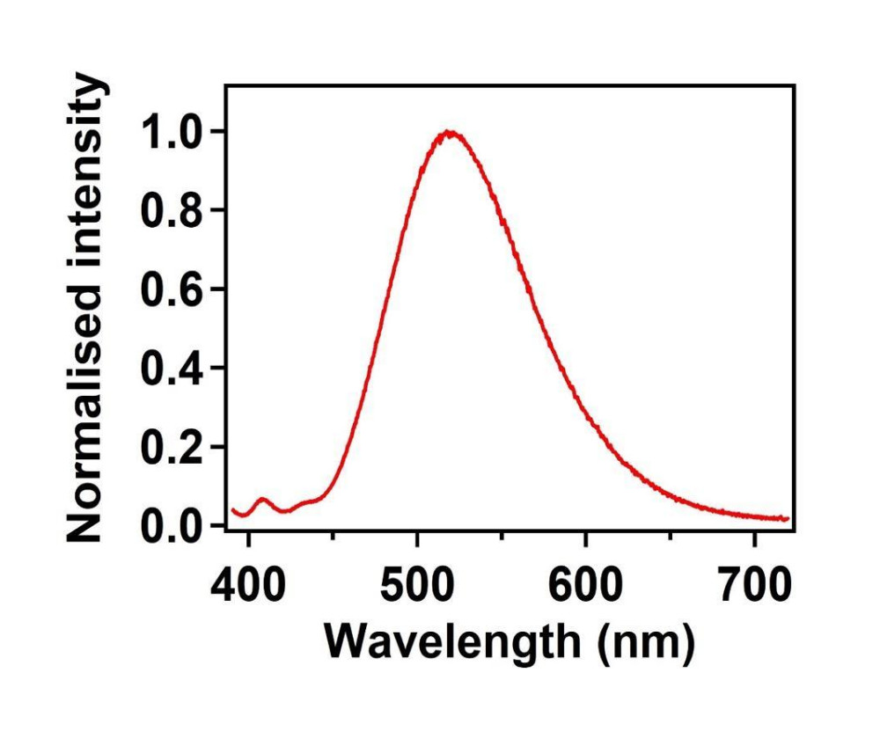
Experimental Observation
Absorption spectra of AN₂@OA₂ complex (maxima is at 376 nm)
Emission spectra of AN₂@OA₂ complex with initial excitation at 376 nm. Emission maxima
peak corresponding to 520 nm, is due to excimer.

Slide 7
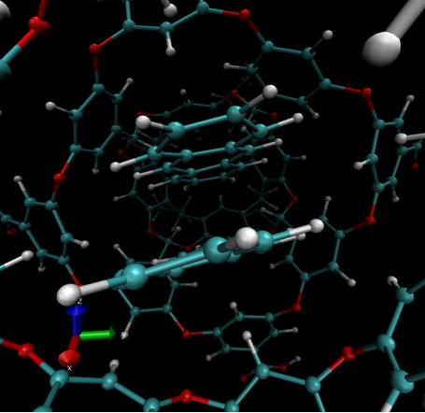
Quantum mechanical model for excited state dynamics
Considering the large size of the system (432 atoms for the AN₂@OA₂ complex), we employed a mixed QM/MM approach to explore the mechanism of excimer formation .
The quantum mechanical (QM) calculations used density functional theory (DFT) for ground and time-dependent DFT (TDDFT) for excited states.
AN dimer was modelled as QM with CAM-B3LYP exchange-correlation (xc) functional along with the BJ-damped Grimme’s D3 dispersion (CAM-B3LYP-D3BJ) and a 6-31G(d,p) basis set.
The OA cage was treated with Molecular Mechanics (MM) using the AMBER03 force field.
The total QM/MM energy of the system was calculated as
E_{QM/MM} = E_{QM}+E_{MM}+E_{QM-MM}
To obtain the insight of the excimer formation we investigate the PEC along a ,b , c- axis from optimized geometry.
QM atoms
MM atoms

Slide 8
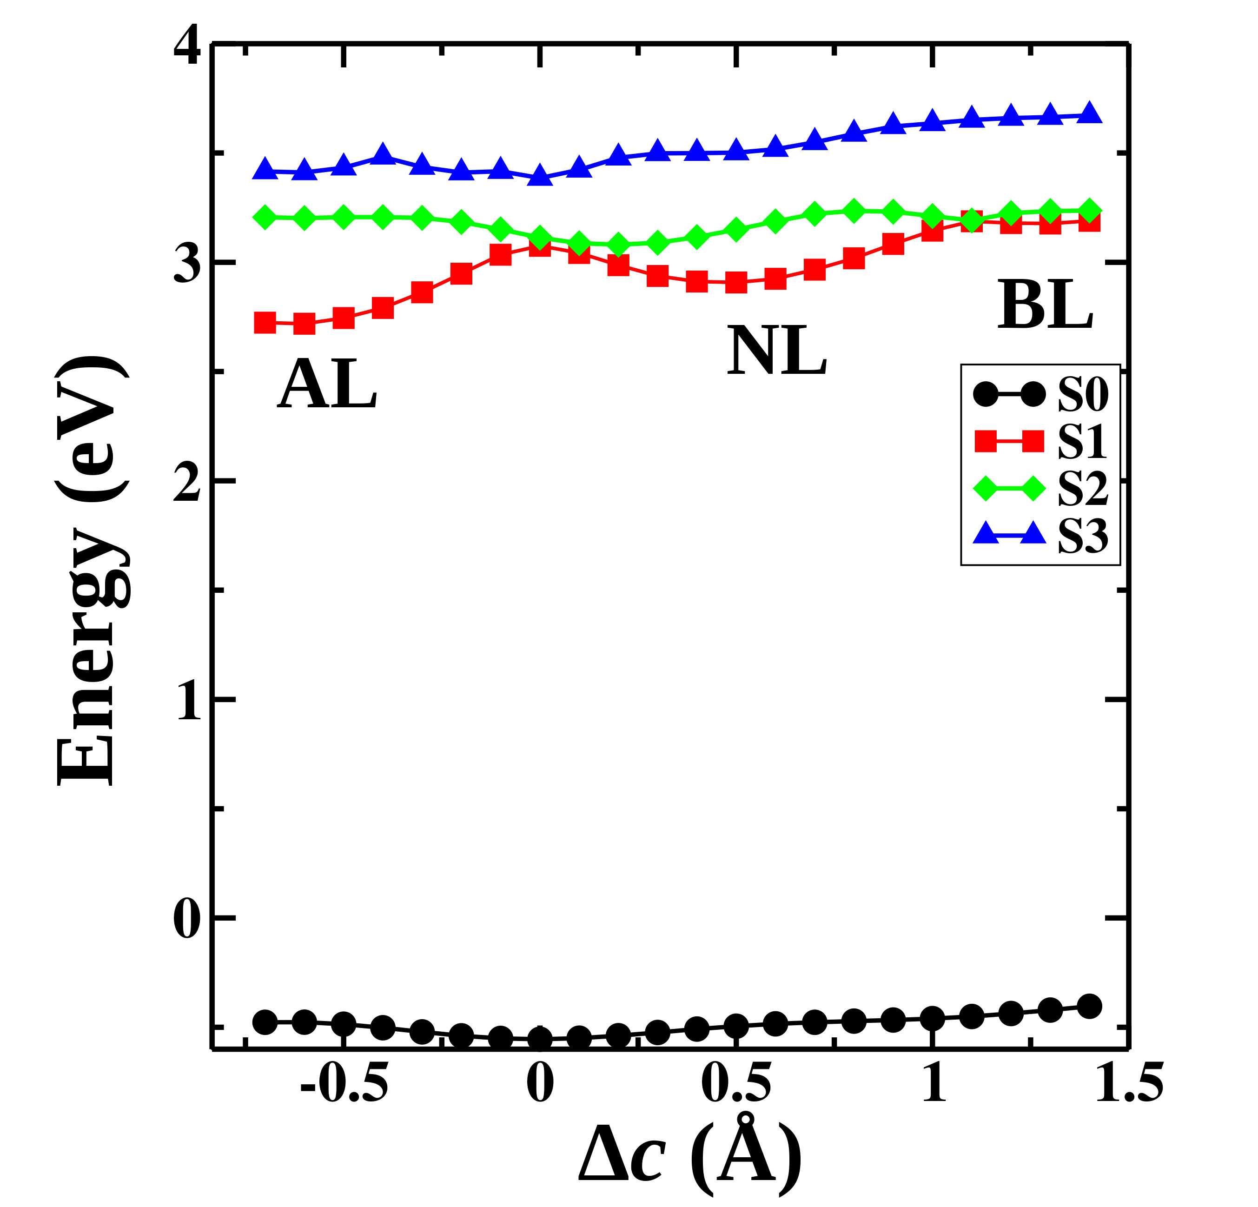
Gas-phase potential energy curve (PEC)
To explain excimer, PEC is calculated with CAM-BLYP/6-31G** level of theory along with D3BJ dispersion correction.
PEC is symmetric about sandwich like geometry with a avoided crossing between S₁ and S₂.
Anthracene Like excimer(AL)
Naphthalene like excimer (NL)
Benzene like excimer (BL)
Gas-phase PEC along c-axis

Slide 9
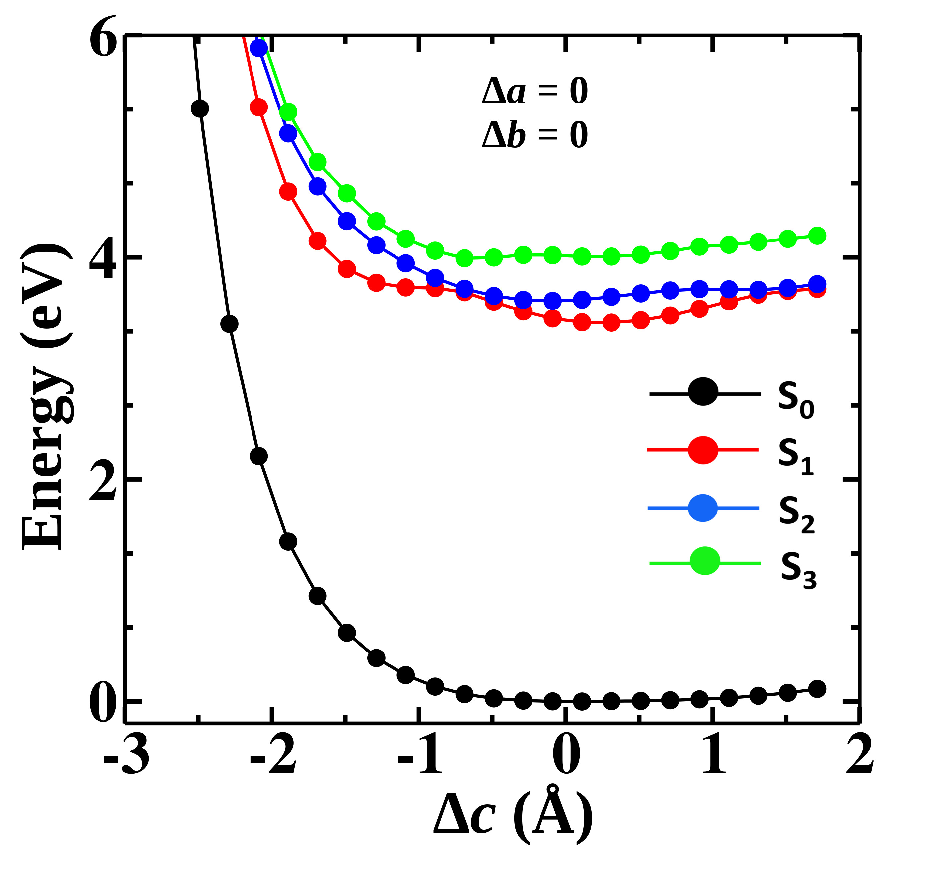
PEC along c-axis in confined phase
Though in gas phase the PEC is symmetric about sandwich like geometry, but in confined environment clearly it's not the case.
PEC shoots up after a certain point due to interaction with cage.
In gas-phase, we can clearly see the three types of excimer among which AL one is the most stable. But inside Octa-Acid, NL excimer is more stable than AL excimer.
AL
NL
NL
PEC​ along c-axis inside OA cage

Slide 10
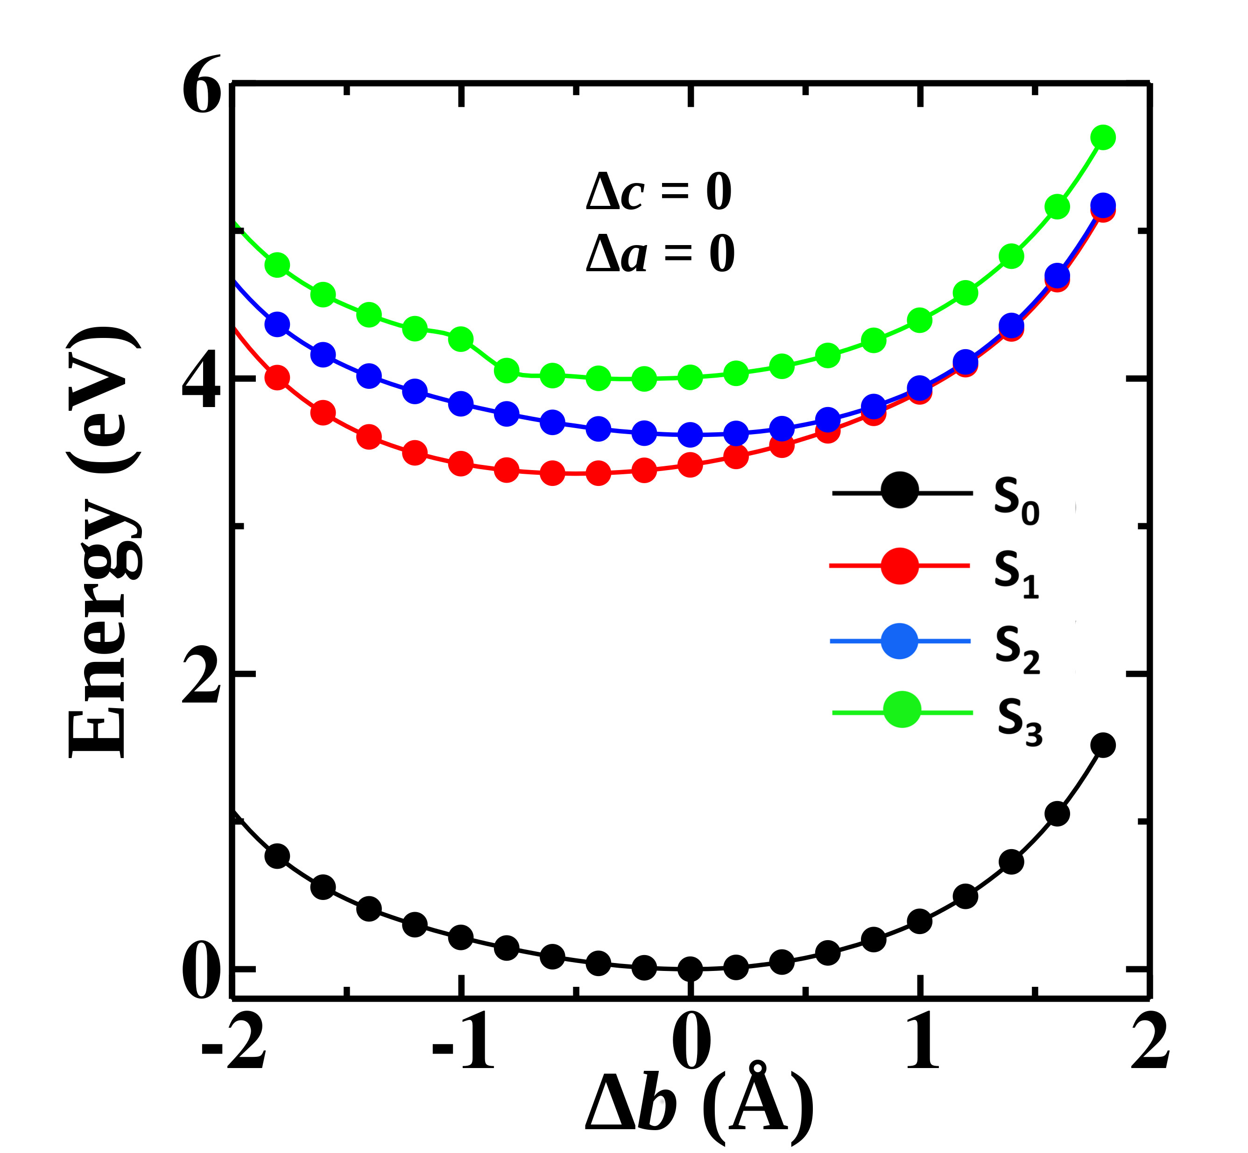
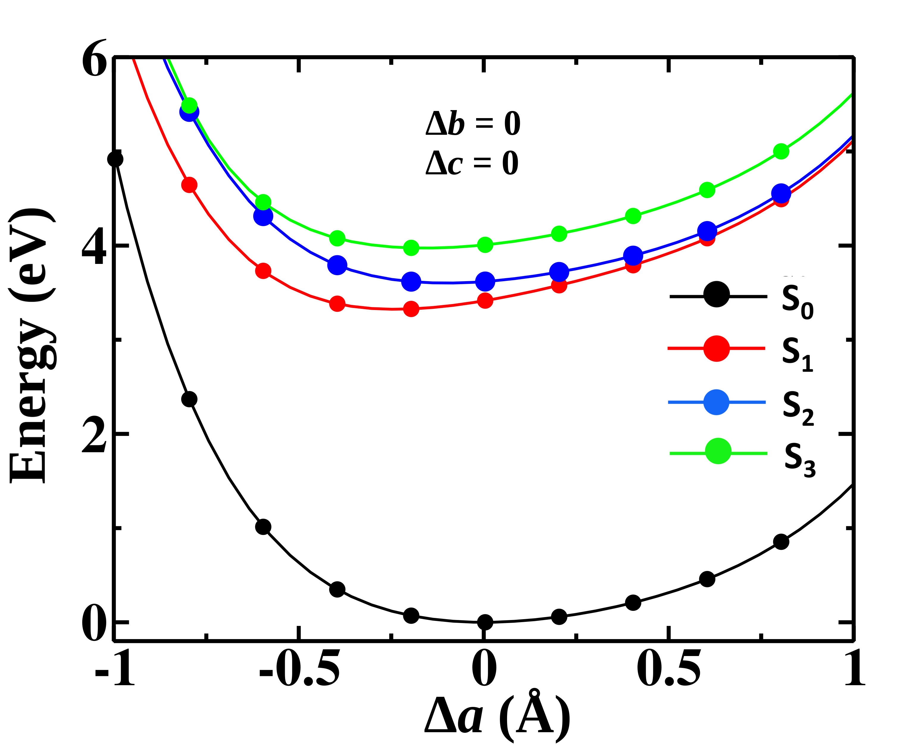
PEC along a and b - axis
a) b)
PEC along a-axis inside OA cage
PEC along a-axis inside OA cage
Along a-axis S₁ has a minimum at 3.31Å (Δa = – 0.23 Å) and along b-axis the minimum is at 0.47 Å (Δb = – 0.53 Å).

Slide 11
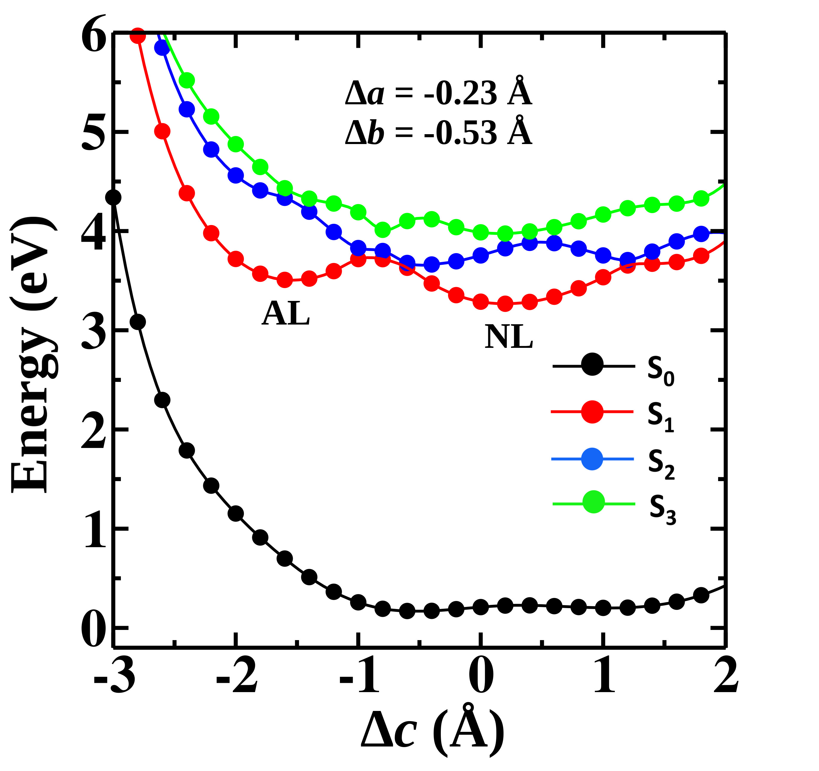
Predicting emission maxima
To predict the emission maxima, we recomputed the PEC along c with the optimal values for a and b in the S₁ manifold. ​
From this plot we computed emission maxima form AL and NL minima.
​ | AL ​ | NL​ | Exp.​
Emission maxima​ | 441 nm​ | 407 nm | 520 nm​
This discrepancy between theoretical and experimental emission wavelengths is likely because of the oversimplified approach employed to guess the minimum along S₁. For more accurate results, excited state (S₁) optimized structure will be helpful.

Slide 12
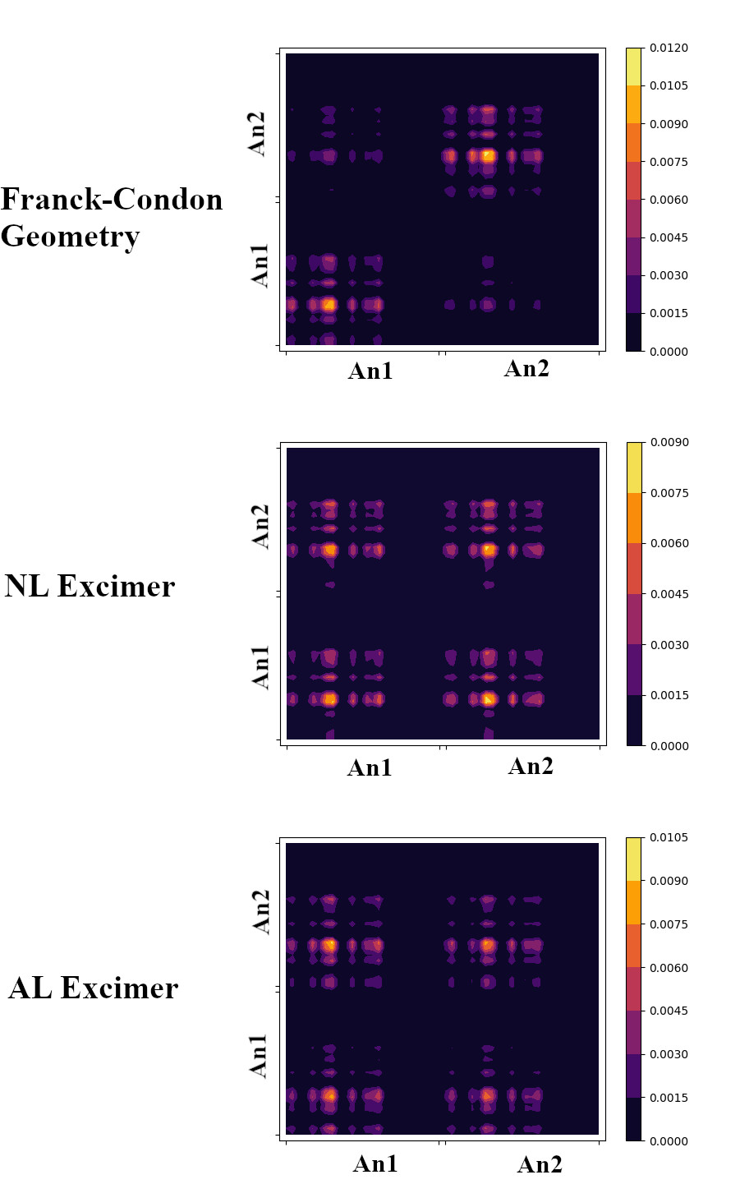
NTOs and transition density matrix
Nature of transition
Predominantly local
Local
+
Charge transfer
Local ​
+ ​
Charge transfer​
Natural Transition Orbitals (NTOs) at three main geometry with CAM-B3LYP-DBJ/6-31g(d,p)
Transition density matrix heat-map plots in FC, NL, AL geometry.

Slide 13
Predicting the mechanism
Mechanism 1
Photoexcitation
Excitation to S₁ (363nm)
Reaches NL minima
Gradually converted to AL minima
Comes down to S₀
Photoexcitation
Excitation to S₂ (having high OS)
Reaches NL minima
Gradually converted to AL minima
Crossing occurs between S₁ & S₂
Comes down to S₀
Mechanism 2
Mechanism-1 is most likely as in the experiment, S₁ state is targeted.
We have started from one optimized structure. But the system does not remain only in one configuration. We assume that putting more degrees of freedom on the system may help S₁ to pick up oscillator strength.

Slide 14
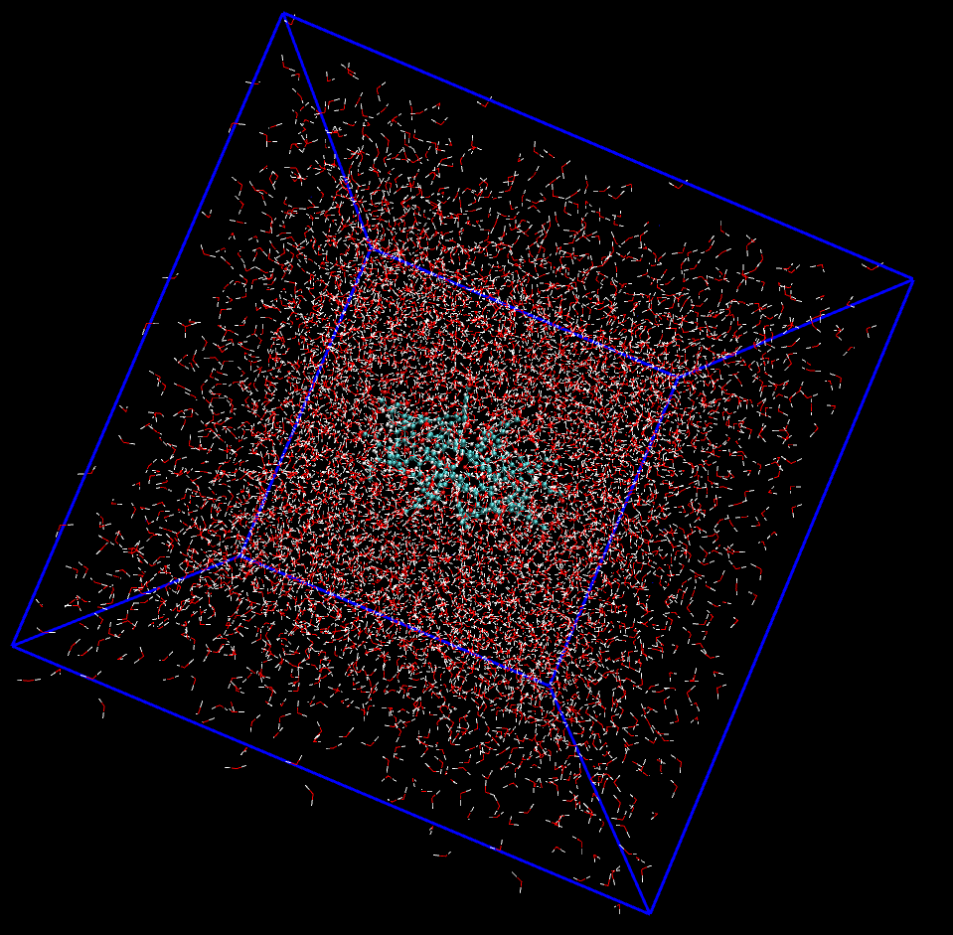
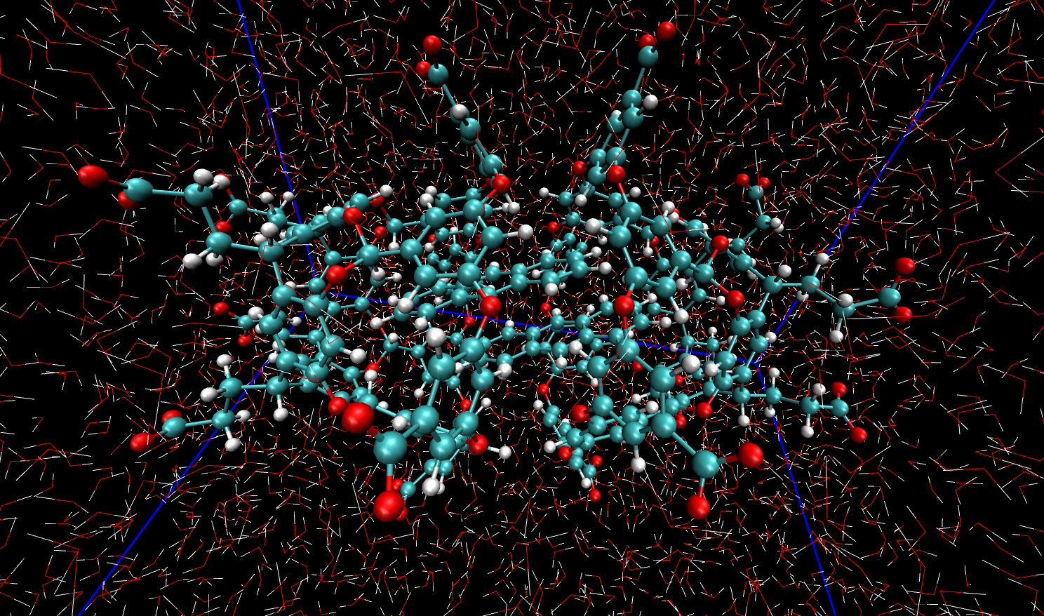

Molecular dynamics simulations
Box size = 60 Å
Temperature = 298 K
Pressure = 1 bar
Step size = 2 fs
This helps to explore several configuration that the system can explore at the particular condition i.e. temperature and pressure.
100 ns
NPT simulation

Slide 15
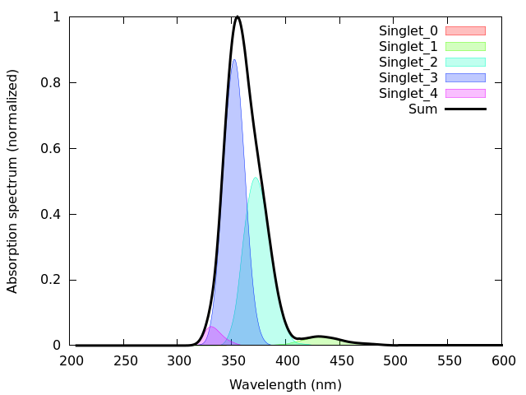
Simulating absorption spectra
From the MD trajectory we choose structures which have a, b, c values within the range of ∓0.2 from the QM/MM optimized a, b, c values.
On these structures we performed LR-TDDFT with CAM-B3LYP-D3BJ/cc-pvdz. The overall spectrum was obtained as an average of all the individual spectra.
Now we can see S₁ has some oscillator strength. So it is no longer a dark state.

Slide 16
Conclusions
Our theoretical results are in well agreement with experimental results.
The PEC we computed clearly shows that in the S₁ state, there is a finite barrier between NL and AL type excimer. Time-resolved area normalized emission spectra (TRANES) also shows that the excimer formation is a two-step process that involves a barrier.
The excimers have a strong charge transfer character which leads to the red shift in the emission spectra.
Currently we are trying to find important optimized geometries in excited state. Along with this , we are also trying to find how the NL excimer converted to AL excimer.

Slide 17
Acknowledgement
In the first place I would like to thank my supervisor Dr. Varadharajan Srinivasan for his constant support and motivation.
I would like to thank my parents and teachers.
IISER Bhopal.
HPC facility and Aryabhatta cluster.
Thanks to my committee members for their time.
Thanks to AITG lab members especially Satyajit da, Deepti di, Elious and Rashid for helping me with discussions.
Thank You!

Slide 18
Backup Slides

Slide 19
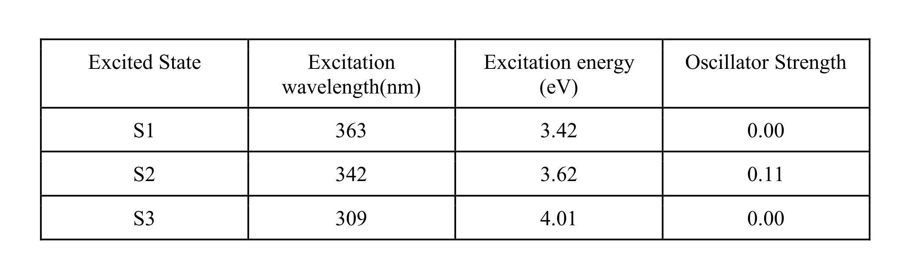
Optimized structure and spectra
Distanc along (ang)​ | Md-avg​ | b3lyp-D2​ | camb3lyp-D2​ | camb3lyp-D3​
a-axis​ | 3.464 Å​ | 3.342 Å​ | 3.193 Å​ | 3.544 Å​
b-axis​ | 0.449 Å​ | 0.910 Å​ | 0.859 Å​ | 1.003 Å​
c-axis​ | 1.615 Å​ | 1.686 Å​ | 1.477 Å​ | 2.089 Å​

Slide 20
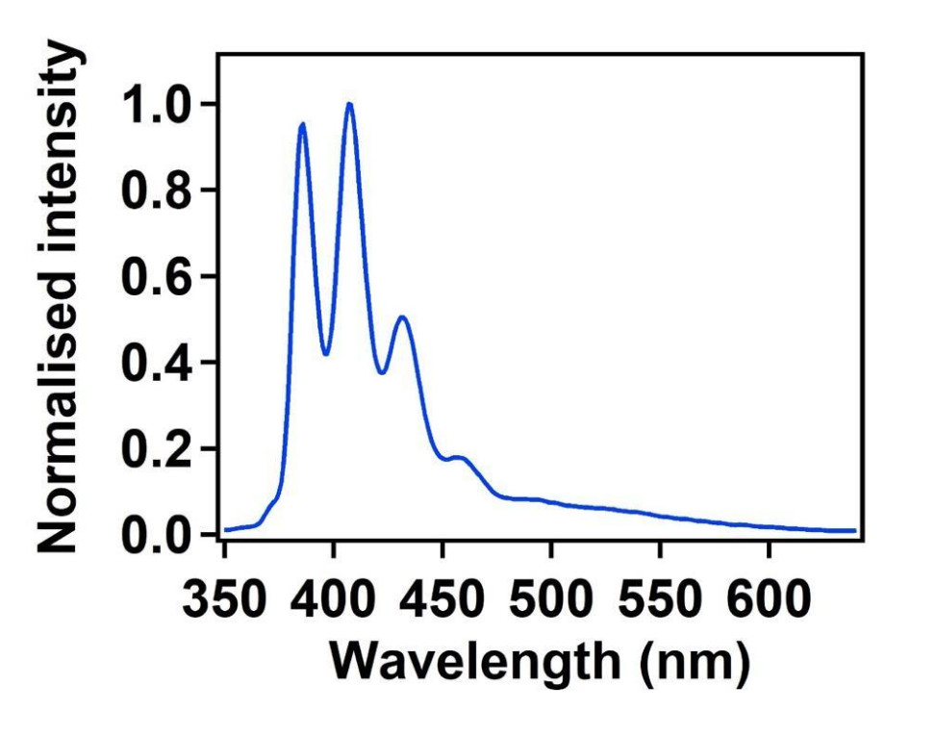
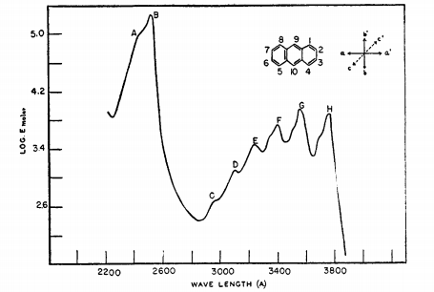
Spectra
Emission Spectra of AN@OA2 complex
Anthracene monomer absorption in ethanol

Slide 21
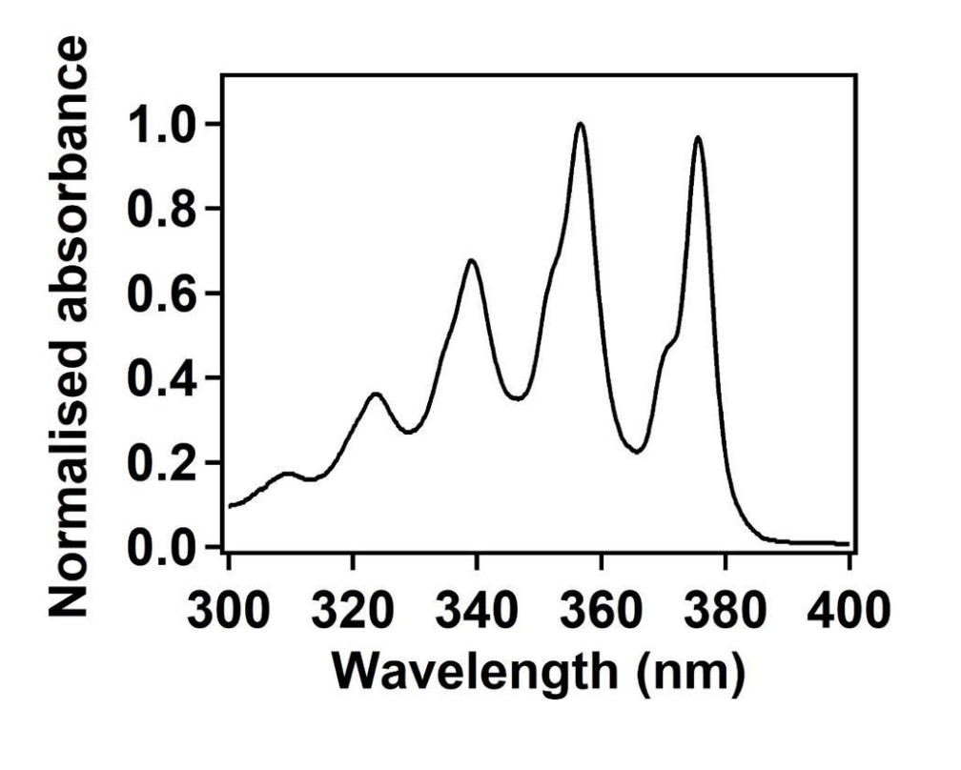
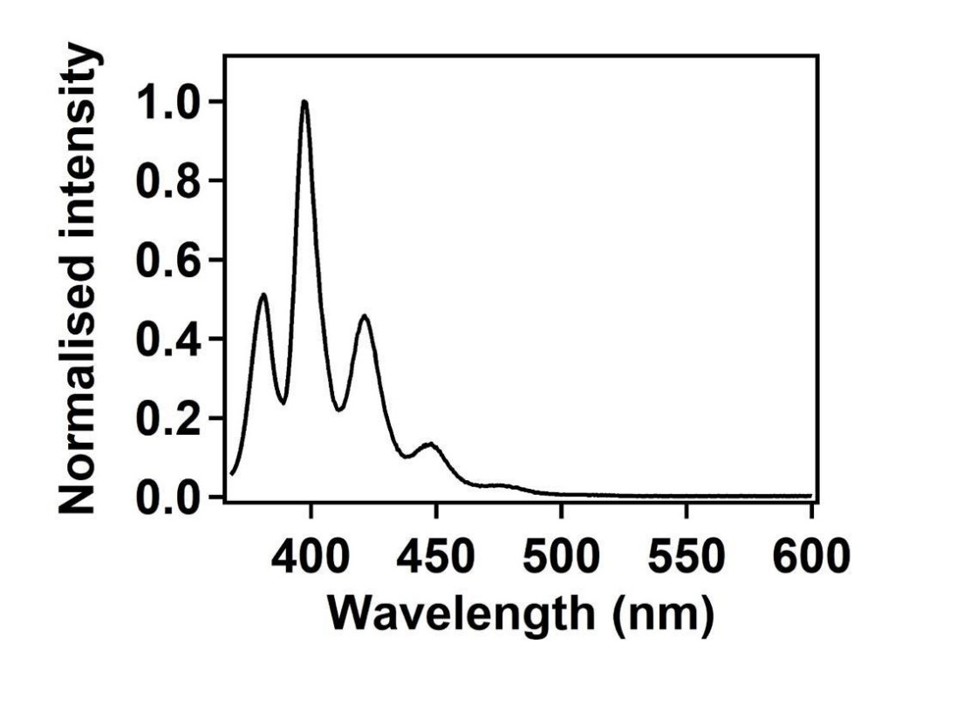
Spectra
. Absorption spectrum of AN in cyclohexane
Emission spectrum of AN in cyclohexane, , ( 350 nm)

Slide 22
Comparison between different xc-functionals
As a first step, we test the quality of basis set and xc functional on gas-phase Anthracene dimer.
Optimization and spectra calculation was done on the same level of theory.
State​ | W-B97xD | CAM-B3LYP-D3BJ | MO6-2X | MO6-2X-D3
S_{1​} | 3.63 eV(0.00) | 3.63 eV(0.00) | 3.62 eV(0.10) | 3.62 eV(0.10)
S_{2​} | 3.67eV(0.12) | 3.67 eV(0.12) | 3.64 eV(0.00) | 3.64 eV(0.00)
S_{3​} | 3.97eV(0.00) | 3.94 eV(0.00) | 3.82 eV(0.00) | 3.82 eV(0.00)
All The calculations were done with 6-31G** basis set.​
Excitation energies are same for mentioned functionals.​
M06-2x have a higher oscillator strength in S₁ whereas w-B97xD and CAM-B3LYP-D3 have higher oscillator strength in S₂. But M06-2x is known not to predict structures having π-π interactions. ​
Structural parameters​ | CAM-B3LYP-D3BJ | W-B97xD | M06-2X | M06-2X-D3
a (Å)​ | 3.45 ​ | 3.36 | 3.29 | 3.30
b (Å)​ | 1.03 ​ | 1.04 | 1.06 | 1.06
c (Å)​ | 1.28​ | 1.28 | 1.28 | 1.28
Inter-planar cosine ​ | 0.99​ | 0.99 | 0.99 | 0.99

Slide 23
Comparison between different basis sets
All the calculations were done with CAM-B3LYP-D3BJ functional on gas-phase anthracene dimer.
Structural parameters | 6-31g** | 6-31+g* | 6-31+g** | 6-31++g**
a (Å) | 3.45 | 3.46 | 3.46 | 3.46
b (Å) | 1.03 | 1.13 | 1.13 | 1.12
c (Å) | 1.28 | 1.33 | 1.33 | 1.33
Inter-planar cosine | 0.99 | 0.99 | 0.99 | 0.99
Excitation Energy and Oscillator strength(in parenthesis) are very close with different basis sets.
State | 6-31g** | 6-31+g* | 6-31+g** | 6-31++g**
S₁ | 3.62 eV (0.00) | 3.55 eV (0.00) | 3.55 eV (0.00) | 3.55 eV (0.00)
S₂ | 3.67 eV (0.12) | 3.59 eV (0.11) | 3.59 eV (0.11) | 3.59 eV (0.11)
S₃ | 3.94 eV (0.00) | 3.89 eV (0.00) | 3.89 eV (0.00) | 3.89 eV (0.00)
Structural parameters with and without diffuse function ( in basis set)are very close .
Increase the size of basis set increases computation time.

Slide 24
Structural Properties :
Displacement Direction | Gas-phase (Å) | Inside OA cage (Å)
a | 3.45 | 3.54
b | 1.03 | 1.00
c | 1.28 | 2.09
Structural parameters for anthracene dimer in the gas phase and the octa acid cage from density-functional theory ground state optimization at CAM-B3LYP-D3BJ/6-31G(d,p) level.
Inside OA cage the Anthracenes are more displaced along c- axis.
Spectra of An2@OA2 complex with QM/MM :
Excited State | Excitation wavelength(nm) | Excitation energy (eV) | Oscillator Strength
S1 | 363 | 3.42 | 0.00
S2 | 342 | 3.62 | 0.11
S3 | 309 | 4.01 | 0.00

Slide 25
Comparison between different basis sets
All the calculations were done with CAM-B3LYP-D3BJ functional on gas-phase anthracene dimer.
Structural parameters with and without diffuse function ( in basis set)are very close .
Increase the size of basis set increases computation time.
Structural parameters | 6-31g** | 6-31+g* | 6-31+g** | 6-31++g**
a (Å) | 3.45 | 3.46 | 3.46 | 3.46
b (Å) | 1.03 | 1.13 | 1.13 | 1.12
c (Å) | 1.28 | 1.33 | 1.33 | 1.33
Inter-planar cosine | 0.99 | 0.99 | 0.99 | 0.99
State | 6-31g** | 6-31+g* | 6-31+g** | 6-31++g**
S1 | 3.62 eV (0.00) | 3.55 eV (0.00) | 3.55 eV (0.00) | 3.55 eV (0.00)
S2 | 3.67 eV (0.12) | 3.59 eV (0.11) | 3.59 eV (0.11) | 3.59 eV (0.11)
S3 | 3.94 eV (0.00) | 3.89 eV (0.00) | 3.89 eV (0.00) | 3.89 eV (0.00)
Excitation Energy and Oscillator strength(in parenthesis) are very close with different basis sets.

Slide 26
Comparison between different basis sets
Basis Set | Ground State energy (a.u.) | Binding Energy(eV)
6-31g** | -1078.516 | -0.36
6-31+g* | -1078.519 | -0.41
6-31+g** | -1078.550 | -0.41
6-31++g** | -1078.550 | -0.42
Binding energies mentioned here is with BSSE correction.
Using diffuse functions in basis set gives us higher binding energy.
 | AL |  | NL
 | 6-31g** | 6-31++g** | 6-31g* | 6-31++g**
Relative position(w.r.t. optimized structure)(Å) | -1.24 | -1.33 | 0.93 | 0.88
Barrier hight | 0.33 eV | 0.38 eV | 0.15 eV | 0.18 eV
Relative position of AL and NL excimer does not differ much .
Barrier hight with different basis sets is close enough.

Slide 27
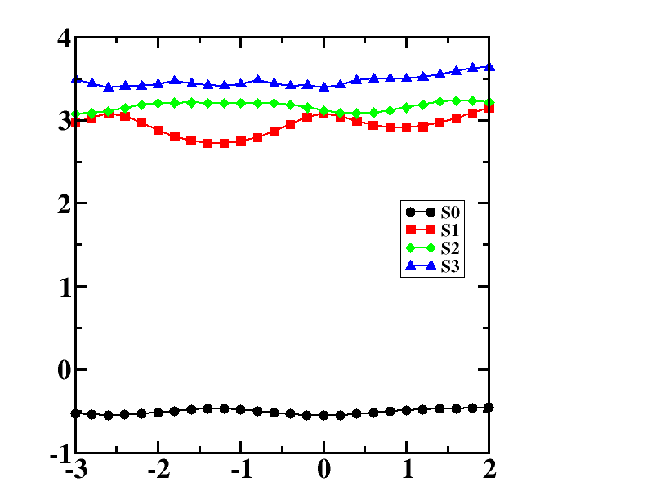
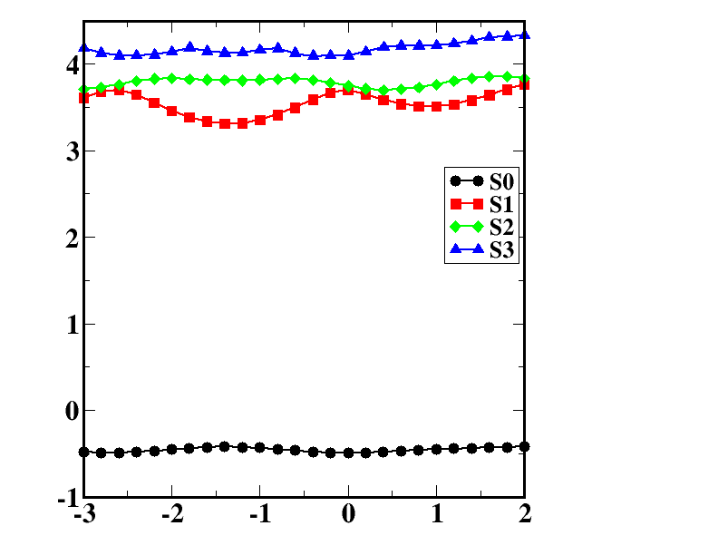
Comparison between PES with different basis sets
With 6-31g**
With 6-31++g**
E_{binding}(eV)
E_{binding(}eV) ​
Comparison between different basis sets​
Δc(Å)
Δc(Å)​
An comparison of plots suggests that overall nature of the PEC is same ,with different basis set.
So we have chosen 6-31g** as our basis set.

Slide 28
Comparison between different Functionals
All The calculations were done with 6-31g** basis set.
Excitation energies are same for mentioned functionals.
M06-2x have a higher oscillator strength in S1 whereas w-B97xD and CAM-B3LYP-D3 have higher oscillator strength in S2.
State​ | W-B97xD | CAM-B3LYP-D3BJ | MO6-2X | MO6-2X-D3
S1​ | 3.63 eV(0.00) | 3.63 eV(0.00) | 3.62 eV(0.10) | 3.62 eV(0.10)
S2​ | 3.67eV(0.12) | 3.67 eV(0.12) | 3.64 eV(0.00) | 3.64 eV(0.00)
S3​ | 3.97eV(0.00) | 3.94 eV(0.00) | 3.82 eV(0.00) | 3.82 eV(0.00)
Structural parameters​ | CAM-B3LYP-D3BJ | W-B97xD | M06-2X | M06-2X-D3
a (Å)​ | 3.45 ​ | 3.36 | 3.29 | 3.30
b (Å)​ | 1.03 ​ | 1.04 | 1.06 | 1.06
c (Å)​ | 1.28​ | 1.28 | 1.28 | 1.28
Inter-planar cosine ​ | 0.99​ | 0.99 | 0.99 | 0.99
Structures obtain by the mentioned functionals are very close wrt b and c.
Slightly vary along a.

